Slide 1
Genetically modified food
Shreya Bhattacharya
Department of Nutrition

Slide 2
Concept
Genetically modified organisms (GMOs) can be defined as organisms (i.e. plants, animals or microorganisms) in which the genetic material (DNA) has been altered in a way that does not occur naturally by mating and/or natural recombination. ... Foods produced from or using GM organisms are often referred to as GM foods.

Slide 3
Concept Of GE Foods
Genetically modified foods (GM foods), also known as genetically engineered foods (GE foods), or bioengineered foods are foods produced from organisms that have had changes introduced into their DNA using the methods of genetic engineering. Genetic engineering techniques allow for the introduction of new traits as well as greater control over traits when compared to previous methods, such as selective breeding and mutation breeding

Slide 4
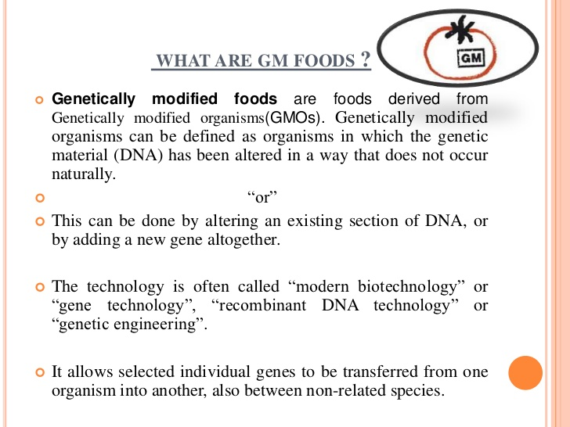
Genetically modified foods

Slide 5
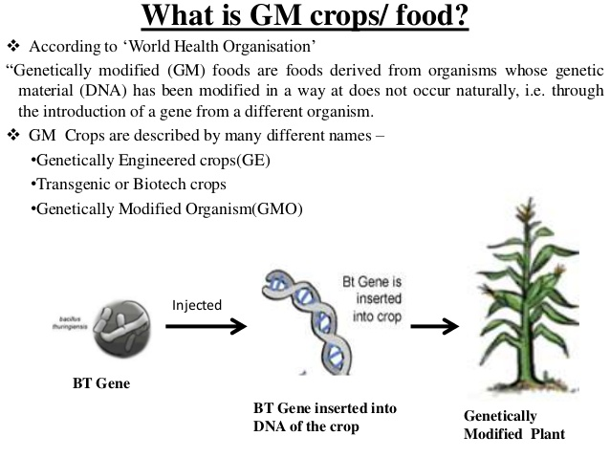
DEFINITION

Slide 6
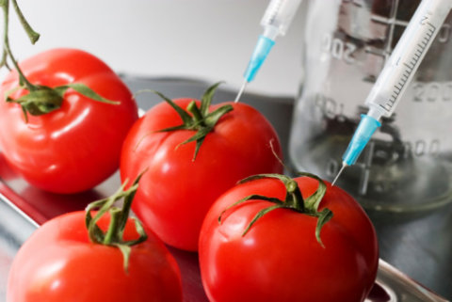
Genetically modified food

Slide 7
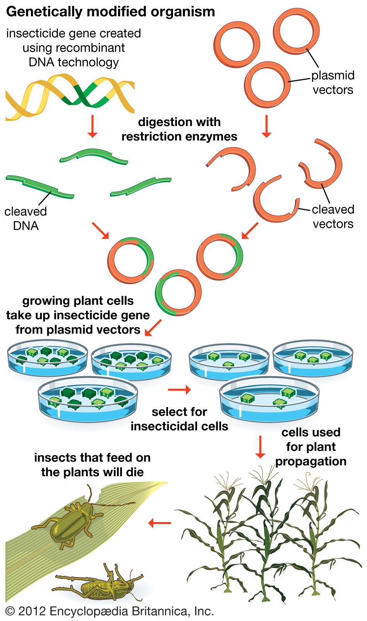
Technique

Slide 8
TECHNIQUE
The shared DNA code
Most organisms store their genetic information in the form of DNA molecules in chromosomes. The sequence of chemical bases in a DNA strand encodes a specific order of amino acids, which are the building blocks of proteins. Proteins carry out many functions in cells and tissues, which together are responsible for an organism’s characteristics. Because most life forms share this same language of heredity—and due to scientific advances in molecular biology—it is now possible to transfer a gene from one species to another, for example from a bacterium to a plant, and have it function in its new host.

Slide 9
TECHNIQUE
What is inserted into a GM plant?
The inserted DNA fragment contains one or a few genes, which contain the DNA sequence information encoding specific proteins, along with DNA segments that regulate production of the proteins. The inserted fragment also sometimes contains a marker gene to easily identify plants that have incorporated the transferred genes, also known as transgenes, into their chromosomes.

Slide 10
TECHNIQUE
How are transgenes inserted?
There are two principal methods for transgene insertion:
Gene gun: In this method, microscopic pellets of gold or tungsten are coated with the transgene fragment and shot at high velocity into plant cells or tissues. In a small proportion of cases, the pellet will pass through the cells and the DNA fragment will remain behind and become incorporated into a plant chromosome in the cell nucleus.

Slide 11
TECHNIQUE
Agrobacterium tumefaciens: This method utilizes a biological vector, the soil dwelling bacterium Agrobacterium tumefaciens, which in nature transfers part of its DNA into plants and causes crown gall disease. Genetic engineers have taken advantage of this DNA transfer mechanism while disarming the disease-causing properties. Plant and bacterial cells are co-cultivated in a petri dish under conditions that facilitate gene transfer. This allows incorporation of genes in a more controlled manner than with the gene gun; however, it does not work equally well in all plant species.

Slide 12
TECHNIQUE
How are whole plants obtained from plant cells or tissues?
Insertion of transgenes is generally an inefficient process, with only a few percent of plant cells or tissues successfully integrating the foreign gene. Various strategies are used to identify the small percentage of cells/tissues that have actually been transformed. The next step is to develop those cells or tissues into whole plants capable of producing seed. This is done through a process called tissue culture, that is, growing plants on agar or a similar medium in the presence of plant nutrients and hormones under controlled environmental conditions.

Slide 13
TECHNIQUE
What happens next?
The crop developers then begin a long series of evaluations to determine that the gene has been incorporated successfully, that it is inherited in a stable and predictable manner, that the desired trait is expressed to the expected level, and that the plant does not show any negative effects. Evaluations are initially done in controlled greenhouses and growth chambers

Slide 14
TECHNIQUE
Once sufficient seed is produced and the appropriate permission is received, experimental plants are grown in field trials. Field evaluations follow strict guidelines that include isolation from related plants to avoid cross-pollination, careful cleaning of planting and harvesting machinery, frequent monitoring of crop growth, and checking the field for two seasons after the trial for the presence of volunteer plants that have arisen from seed inadvertently left behind.

Slide 15
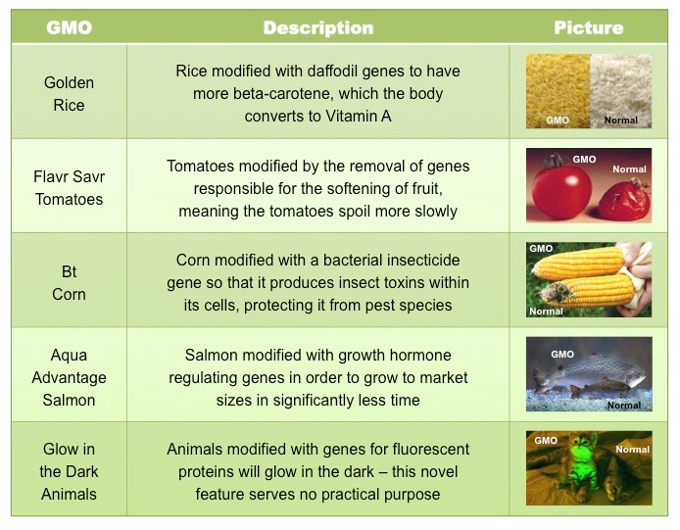
Genetically Modified Food

Slide 16
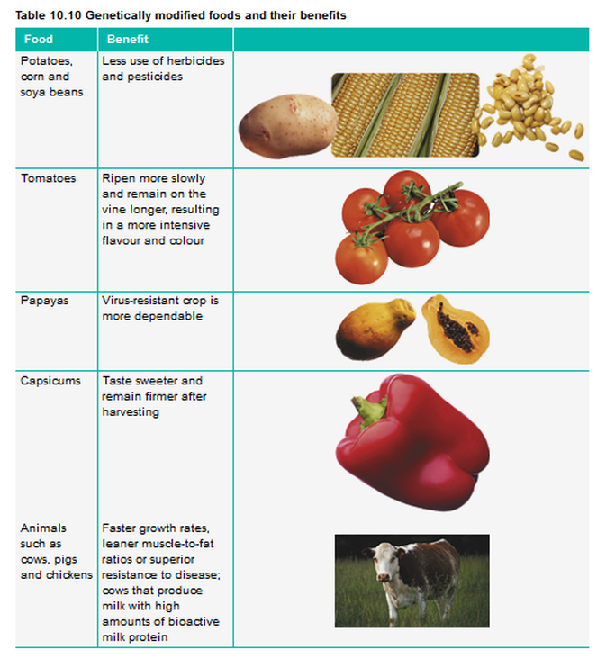

Slide 17
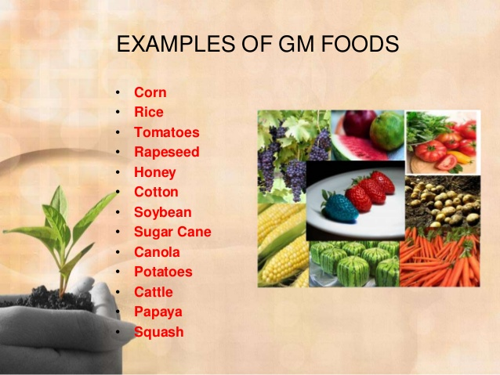
MORE EXAMPLES OF GM FOODS

Slide 18
What are potential GM crops of the future
Some potential applications of GM crop technology are:
Nutritional enhancement: Higher vitamin content; more healthful fatty acid profiles;
Stress tolerance: Tolerance to high and low temperatures, salinity, and drought;
Disease resistance: For example, orange trees resistant to citrus greening disease or American chestnut trees resistant to fungal blight;
Biofuels: Plants with altered cell wall composition for more efficient conversion to ethanol;
Phytoremediation: Plants that extract and concentrate contaminants like heavy metals from polluted sites.

Slide 19
Are GM crops grown in other countries?
According to a recent report (James 2014), GM crops were grown in 26 other countries in 2013. The largest global acreage crops were soybean, corn, cotton, and canola, in that order. The U.S. has the greatest area of these crops, about 40% of the world total. Other large producers include Brazil, Argentina, India, and Canada.

Slide 20
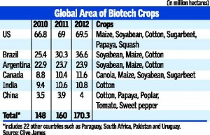
Genetically Modified Crops Production globally

Slide 21
Steps adopted for acceptibility of GM Food
  The land area under cultivation with genetically modified organisms (GMOs) has grown steadily over the last two decades.
  Alleviation of the impacts of climate change and farmers adaptation are some of the arguments for GM crops.
  However, current systems of production, handling and transportation can lead to the unintentional low level presence of GMOs in non-GMO consignments.
  National policies and regulations that govern the acceptability of GM crops vary, and a number of traderelated problems have been reported as a result of the unintentional mixing of GM and non-GM crops.
  FAO conducted a survey to increase understanding of the extent of trade disruption due to the low level presence (LLP) and adventitious presence (AP) of GMOs.

Slide 22
Advantages and disadvantages
Positive:
Higher Productivity (food security),
Resilience to climatic (drought resistance) and other related (pests, herbs, salinity) problems, less input use.
Nutritionally enriched products

Slide 23
DisadvantageS
Negative:
Higher initial research and input (seed) cost,
Concerns for health (human & animal), ➢
Environment concerns (loss of biodiversity, impact on non-target organisms),
Unintentional gene transfer from GM to non-GM crops
Low level presence and adventitious presence
Limited access to GM seeds (Patenting),

Slide 24
DisadvantageS
Lack of information for consumers (Labeling),
Concerns of traditional farmers, ethical concerns,
Lack of related regulations and technical capacities to detect GMOs in trade. 1Climate Change: Impact on Agriculture and Cost of Adaptation, IFPRI, 2009
An IFPRI Study (2009)1 found that even with no climate change world prices for many agricultural commodities (rice, wheat, maize) will increase by 39-63 % in 2050 driven by population, income growth, biofuels).
Climate change (rise in temperature and change in rainfall patterns) results in additional price increases by 11-100 % even after CO2 fertilization effect.

Slide 25
REFERENCE:
http://www.fao.org/
https://en.wikipedia.org/wiki/Genetically_m
www.slideshare.net
Information collected from different journals,books and other websites

Slide 26
THANK YOU

